Slide 1




Slide 2
What is Language Models (LM) ?
Notes:
Hello and welcome, in this video we will start to dive into the components of the internal structure of transformers.

Slide 3
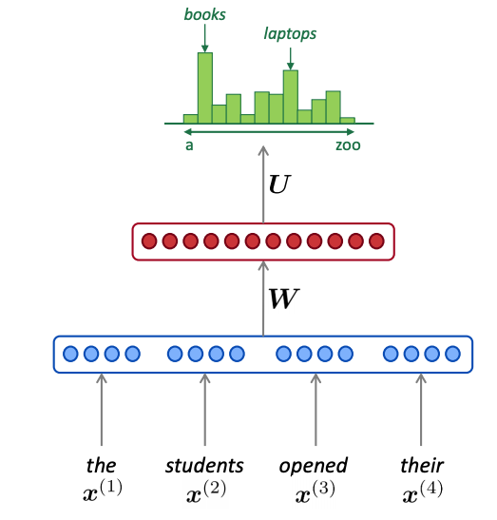
Language Models
A language model is a mathematical representation of a natural language
It assigns a probability to any sequence of words or characters in the language, based on how likely it is to occur in real texts.
https://blog.feedly.com/nlp-breakfast-2-the-rise-of-language-models/

Slide 4
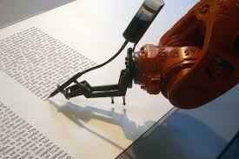
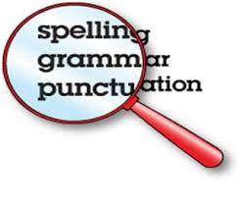
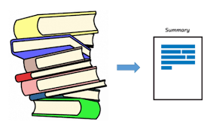

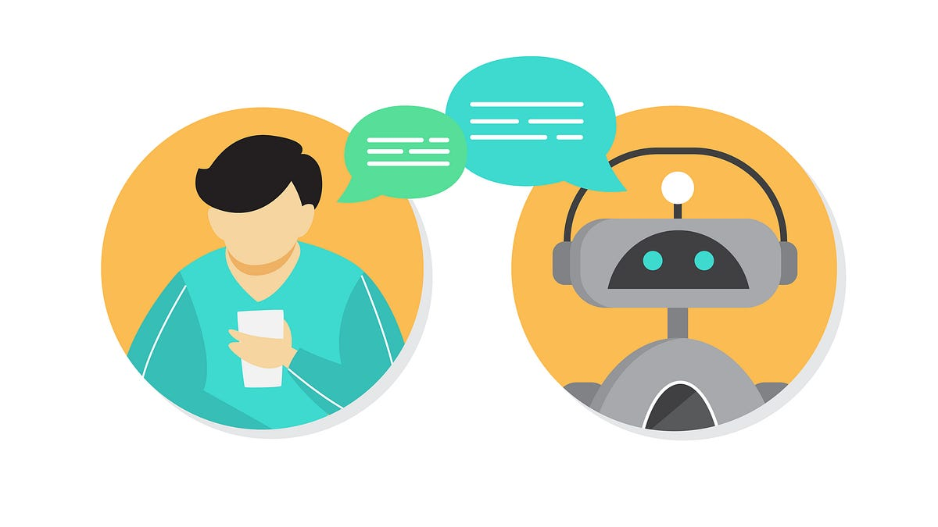

Language Models
A language model can be used for various purposes:
Generating new texts
Correcting spelling or grammar errors
Completing missing words or sentences
Summarizing
Translating
Answering questions.

Slide 5

How Language Models work?
which is a type of machine learning algorithm that can learn from data.
A neural network consists of many interconnected units called neurons, which can perform simple calculations and pass information to each other.
Preprocessing
Text file
Dense
Embeddings

Slide 6
How Language Models work?
which is a type of machine learning algorithm that can learn from data.
A neural network consists of many interconnected units called neurons, which can perform simple calculations and pass information to each other.
By adjusting the connections and weights between the neurons.
the network can learn to approximate any function or pattern in the data.
Sentiment Analysis
Classification
Preprocessing
Topic Modeling
Output
Unit
Translation
Text file
....
Dense
Embeddings

Slide 7
How Language Models work?
Language is sequential and contextual; the meaning and probability of a word depend on its position and surrounding words in the text
Neural network needs to have some memory and attention mechanisms to capture these dependencies.
Sentiment Analysis
Classification
Preprocessing
Topic Modeling
Output
Unit
Translation
Text file
....
Dense
Embeddings

Slide 8
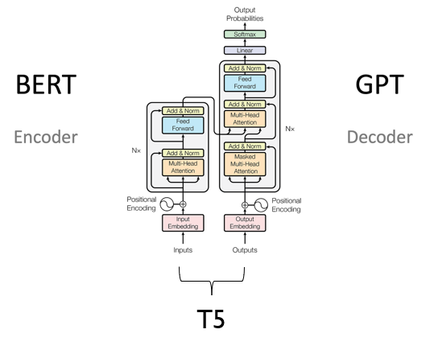
Transformers
Transformers are a type of neural network architecture.
They are designed to handle sequential data, such as text or speech, by using the attention mechanism.
The Attention allows the network to focus on the most relevant parts of the input and output sequences.

Slide 9
what makes you choose transformers LM rather than Non-Transformers LM in performing your NLP task?

Slide 10
LM Transformers Based Vs
LM Non-Transformers Based
More powerful and more expressive
Learn from large amounts of data and capture the global context and long-range dependencies in natural language.
More efficient and scalable
Process the entire input and output sequences in parallel, rather than one token at a time, and use attention to focus on the most relevant parts of the sequences.
More versatile and adaptable
Pre-trained on general language data and fine-tuned for specific downstream tasks with minimal data and computation.
Example: BERT, GPT-3, and T5.
Less powerful and less expressive.
Rely on recurrent or convolutional layers that have a limited memory or receptive field and may struggle to handle long or noisy sequences.
Less efficient
Process the input and output sequences sequentially, which can be slow and memory-intensive, and may require more data and computation to achieve good results.
Less versatile and less adaptable
Usually trained from scratch for each task and may not generalize well to new domains or languages.
Example: RNN and LSTM models.

Slide 11
How can we use Transformers
Pre-training transformers is the process of training a transformer model on a large and general corpus of text, such as Wikipedia or books, without any specific task or objective.
The goal of pre-training is to learn a general representation of natural language that can capture the syntax, semantics, and pragmatics of the language.
Fine-tuning transformers is the process of adapting a pre-trained transformer model to a specific downstream task or domain, such as sentiment analysis or medical text.
The goal of fine-tuning is to leverage the general representation learned by the pre-trained model and adjust it to the specific task or domain.
Pre-Training
Fine-Tuning
Inference
Large unlabeled datasets
(e.g. Wikipedia, bookCropus)
Smaller labelled datasets
(SQuAD,MNLI/CMNLI,
Similarity)
Question Answering
Language generation
Name Entity Recognition
Sentiment Analysis
Summarization and more…
Pre-trained
Weights
Fine-Tuned
Weights
Self-supervised
Training (hours to days)
Task-specific fine tuning
(minutes to hours)

Slide 12
How can we use Transformers
Pre-training and fine-tuning transformers are complementary techniques that can improve the performance and efficiency of natural language processing tasks.
Pre-training allows the model to learn from a large amount of unlabeled data and avoid overfitting to a specific task or domain.
Fine-tuning allows the model to adapt to the task or domain of interest and achieve better results than training from scratch.
Pre-Training
Fine-Tuning
Inference
Large unlabeled datasets
(e.g. Wikipedia, bookCropus)
Smaller labelled datasets
(SQuAD,MNLI/CMNLI,
Similarity)
Question Answering
Language generation
Name Entity Recognition
Sentiment Analysis
Summarization and more…
Pre-trained
Weights
Fine-Tuned
Weights
Self-supervised
Training (hours to days)
Task-specific fine tuning
(minutes to hours)

